Slide 1
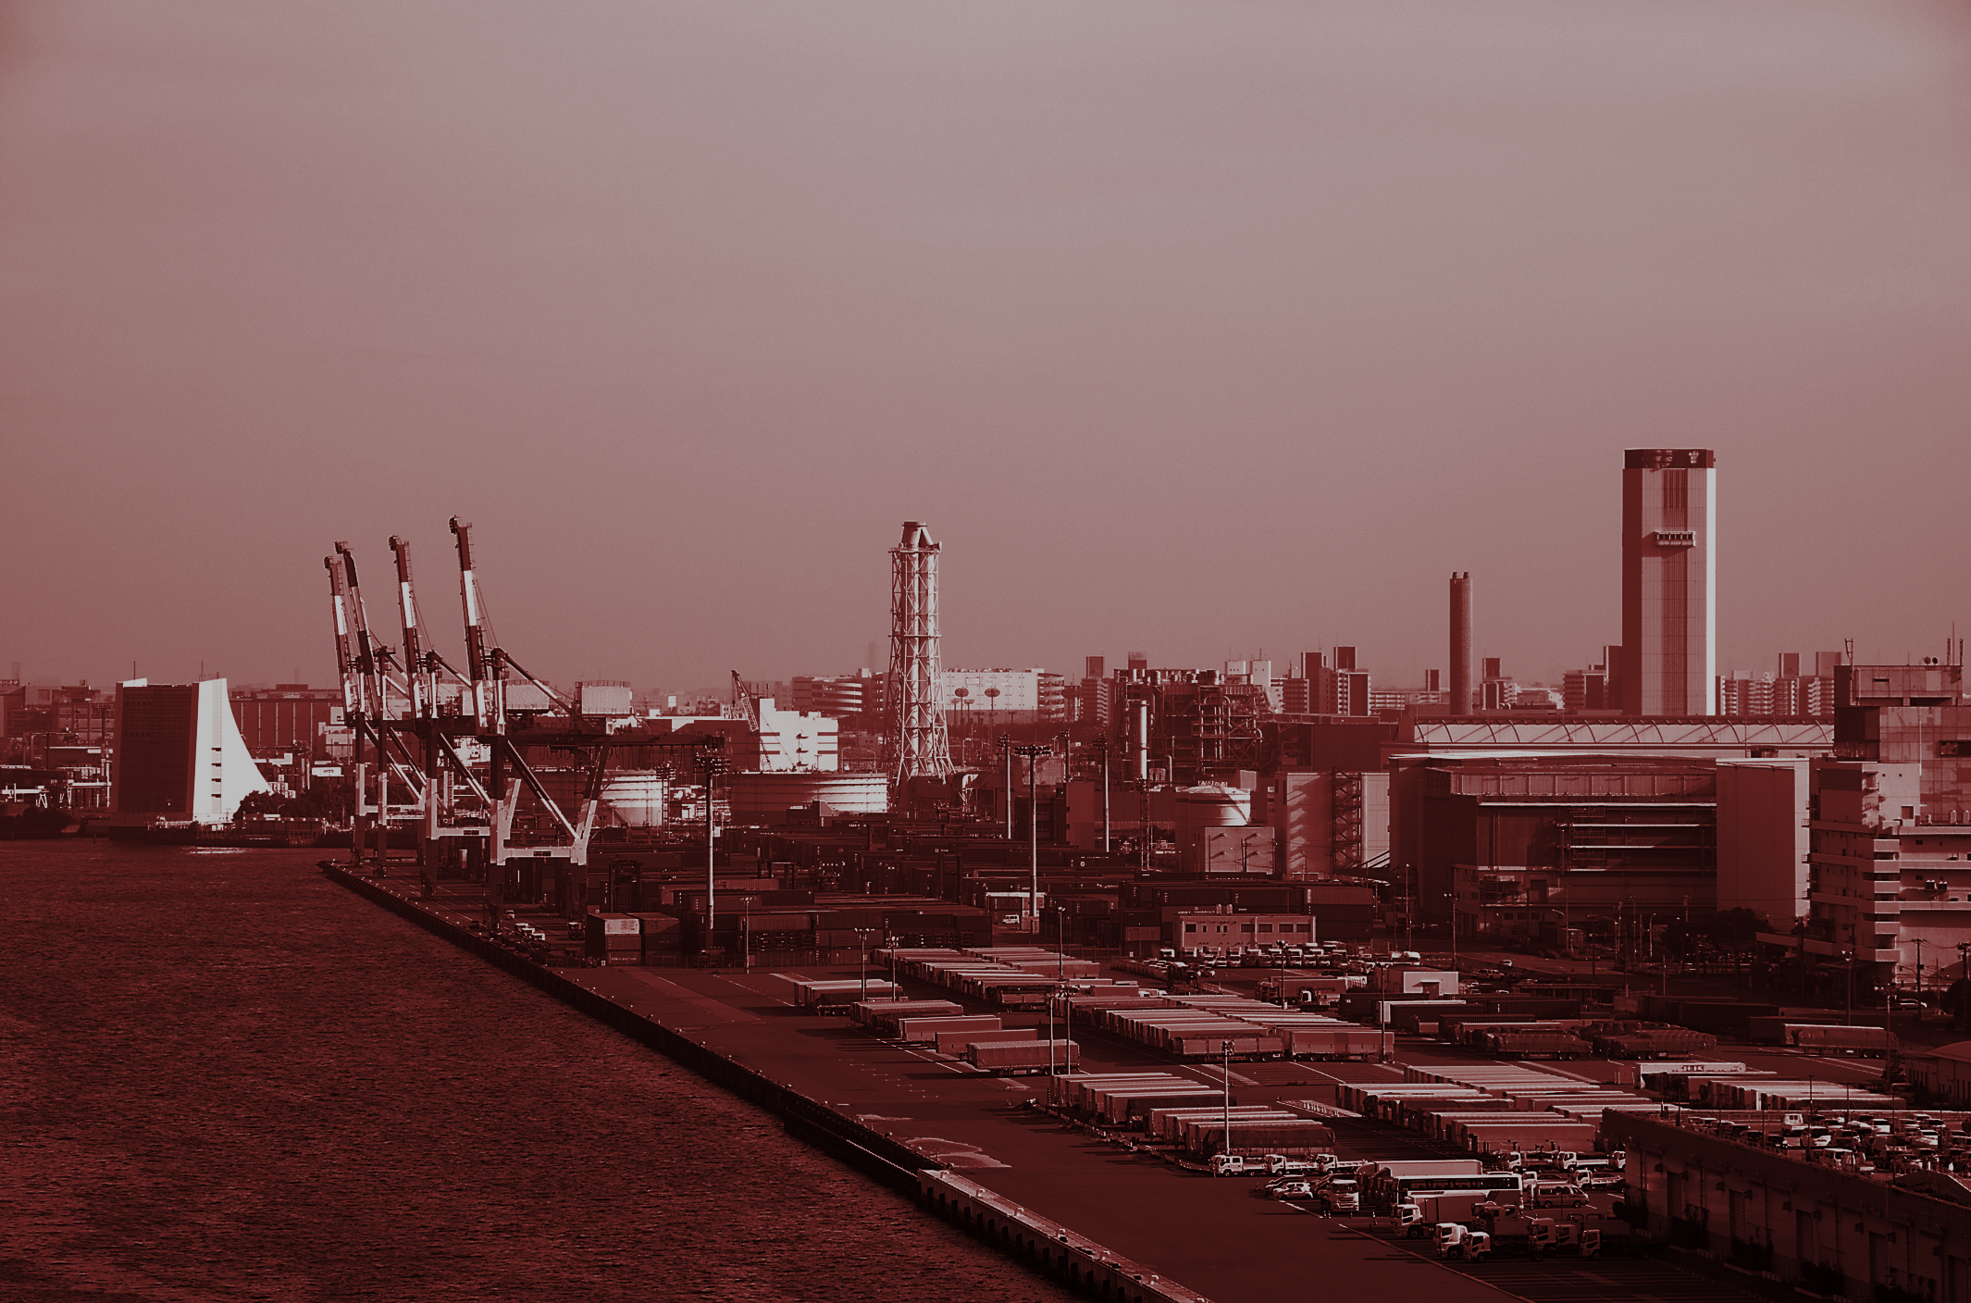


Plenary Panel Blockchain

Slide 2
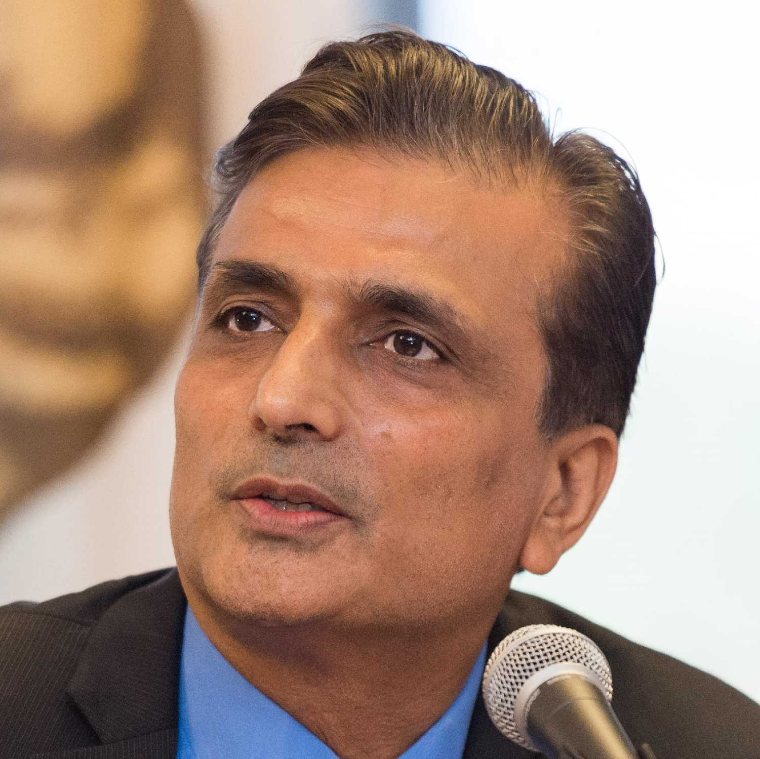
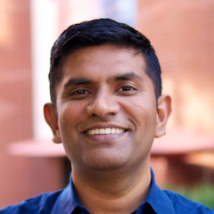



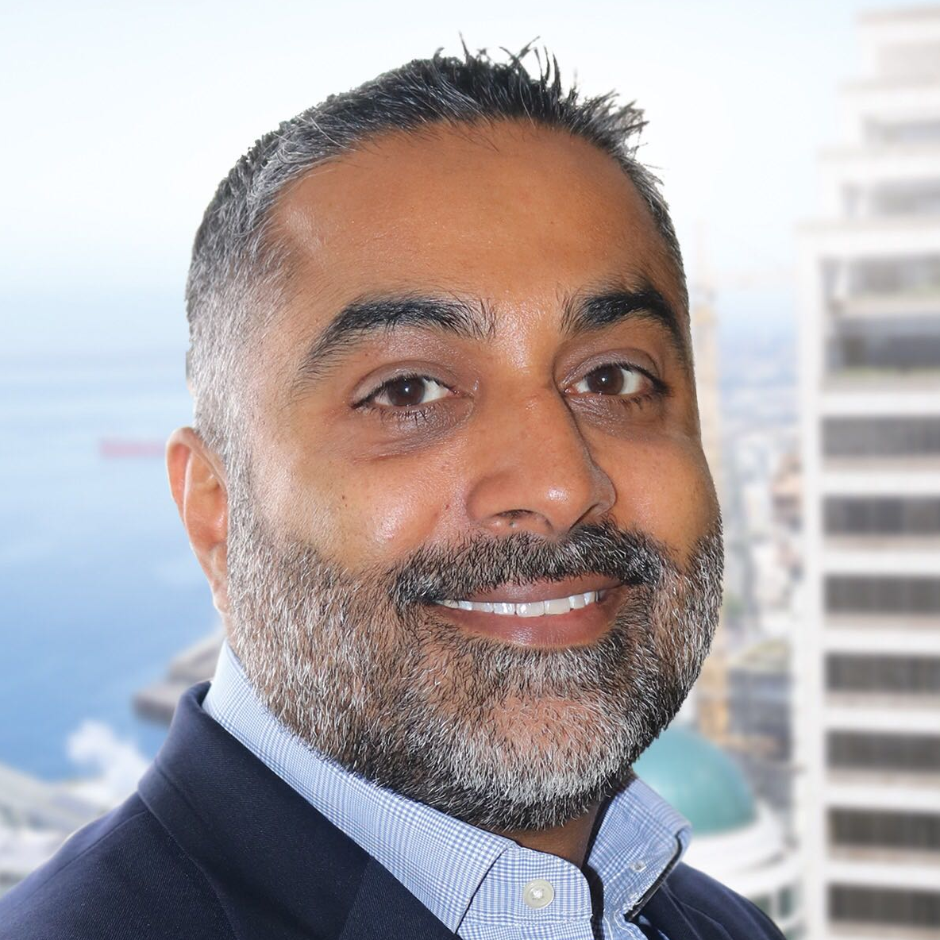
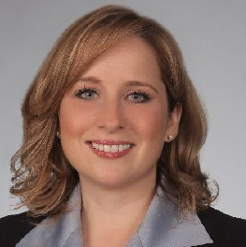


Nick Vyas
USC
Academic Director
Bhaskar Krishnamachari
USC
Engineering Professor
Aljosja Beije
BlockLab Rotterdam
Logistics and Technology Lead
Ann McCormick
Bank of America
Director, Trade and Supply Chain
Kimon Drakopoulos
USC
Assistant Professor of Data Science and Operations
Deep Ghumman
EY
Advisory Services Principal
Alison E. Calfin
Maersk TradeLens
Director of Buisness Development

Slide 3
Aljosja Beije

Slide 4

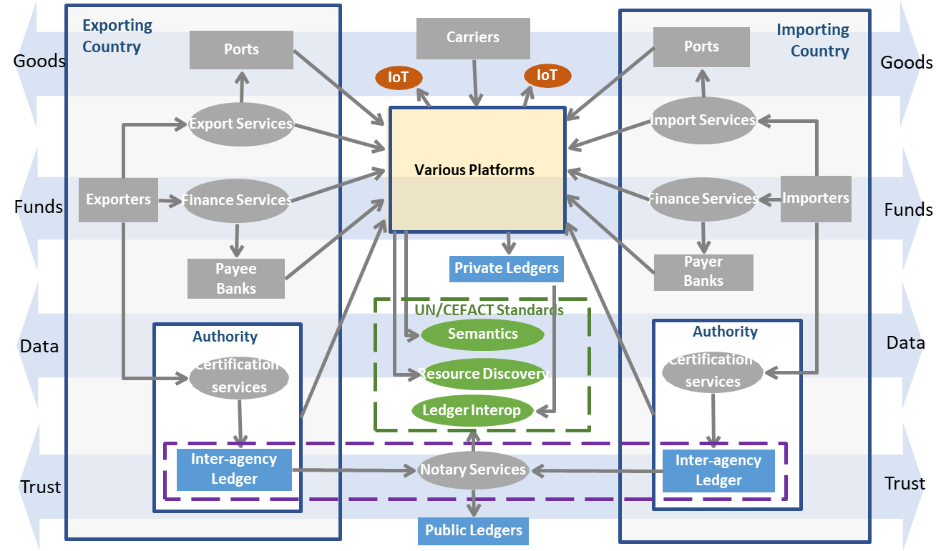

Slide 5
Alison E. Clafin

Slide 6















GLOBAL TRADE IS HIGHLY INEFFICIENT AND BURDENED BY PAPER-BASED PROCESSES
TRADELENS IS BUILT ON AN OPEN TECHNOLOGY STACK AND IS UNDERPINNED BY BLOCKCHAIN TECHNOLOGY

Slide 7

TRADELENS JOURNEY
June 2019
Hapag Lloyd and ONE agree to join. Five of the largest six carriers now plan to be on the TradeLens platform by the end of 2019.
Ocean carrier additions:
CMA and MSC join
Ocean carrier additions:
ZIM joins
Ocean carrier additions:
Seaboard Marine and KMTC join
Ocean carrier additions:
Namsung and Boluda join
December 2018
TradeLens Commercial Release; 1.5 million events per day published to the platform; working with more than 100 ecosystem participants
Ocean carrier additions:
PIL join
Ocean carrier additions:
Maersk Line, Safmarine, Hamburg Sud, Sealand join
September 2018
TradeLens Limited Availability Release
August 2018
Formal launch of the TradeLens
January 2018
Beta release of the platform and launch of Early Adopter Program; trials underway

Slide 8
STANDARDS AND INTEROPERABILITY
TradeLens is a neutral platform that is available to participants of any party to a shipment, anywhere in the world. The platform provides a way for all major logistics and permissioned participants to immediately contribute to and extract value from the TradeLens network.
TradeLens is committed to the promotion and adoption of standards and interoperability of platforms.
Information standardization
TradeLens will work closely with the advisory board, ecosystem members and standards bodies to help the industry develop and adopt standard codes and data models. The TradeLens data model and access control scheme aligns with UN/CEFACT.
Interface standards
TradeLens is committed to openness, with all functionality surfaced via non- proprietary, publicly available APIs that are designed specifically for ease of integration.
Blockchain interoperability
The TradeLens platform has full intentions to follow blockchain-based standards evolving in the industry, inclusive of cross-ledger namespace and transfers or information between ledgers.

Slide 9
PRACTICAL CASE STUDIES
Today, valuable data is locked in paper or unstructured documents that often needs to be re-keyed into a system for use. The process of chasing down documents and then manually updating systems is time consuming and error-prone.
“The TradeLens pilot gives us an opportunity to not only find process efficiencies and gain analytical insights, but improve data providence, accuracy and targeting capabilities. The end result may be a faster and more reliable national supply chain, which could positively impact Canada’s economic output.”
John Ossowski, President, CBSA
CANADIAN PILOT – CBSA Perspective
SAUDI ARABIAN PILOT – BCO Perspective
1.
1.
Multiple sources of information identified discrepancies
Reduced the need for hard copies of shipping documents.
2.
2.
Event data plus documents in one place is beneficial for initial review
Simplified their customs declaration process
3.
3.
Additional data points, like transshipment visibility, port locations, terminal moves and duration of container stay, improved risk assessments
Eliminated shipment-chasing emails and phone calls
4.
Increased the granular visibility of each shipments milestones
4.
Provided more transparency of data upstream in the supply chain
5.
Established connections to international Customs Authorities
6.
Gained visibility of inland-transportation in destination country

Slide 10
Kimon Drakopoulos

Slide 11
Who am I
PhD MIT EECS
Assistant Prof. of Data Sciences and Operations @USC MARSHALL
Research interests: Information in Operations, Contagion, Economics

Slide 12
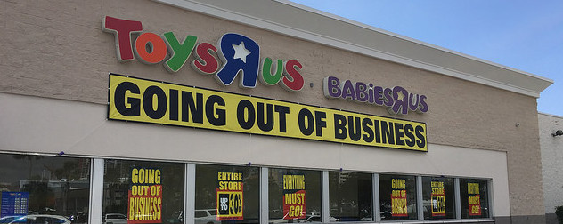
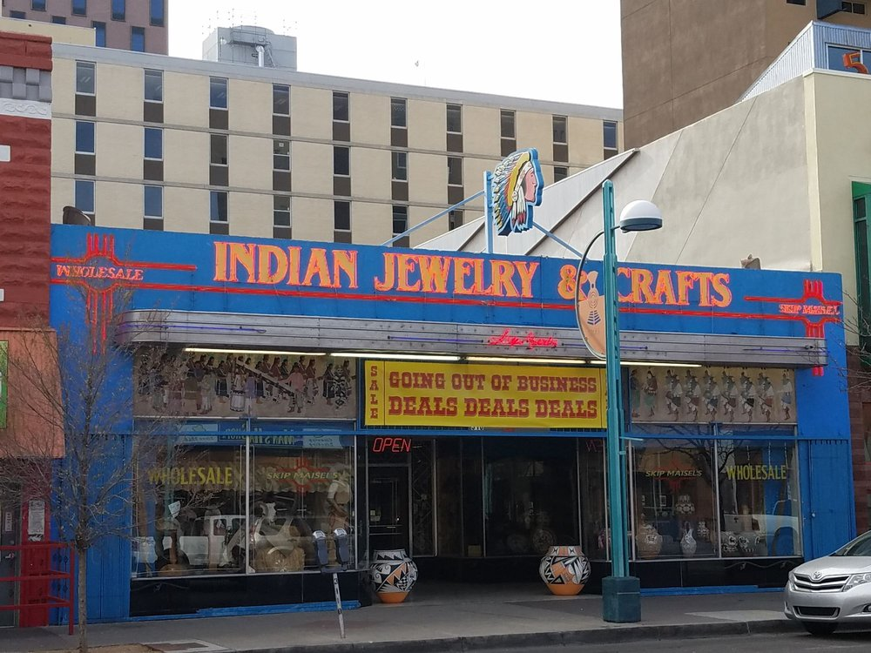
Why Blockchain?
Commitment implementation through smart contracts.

Slide 13

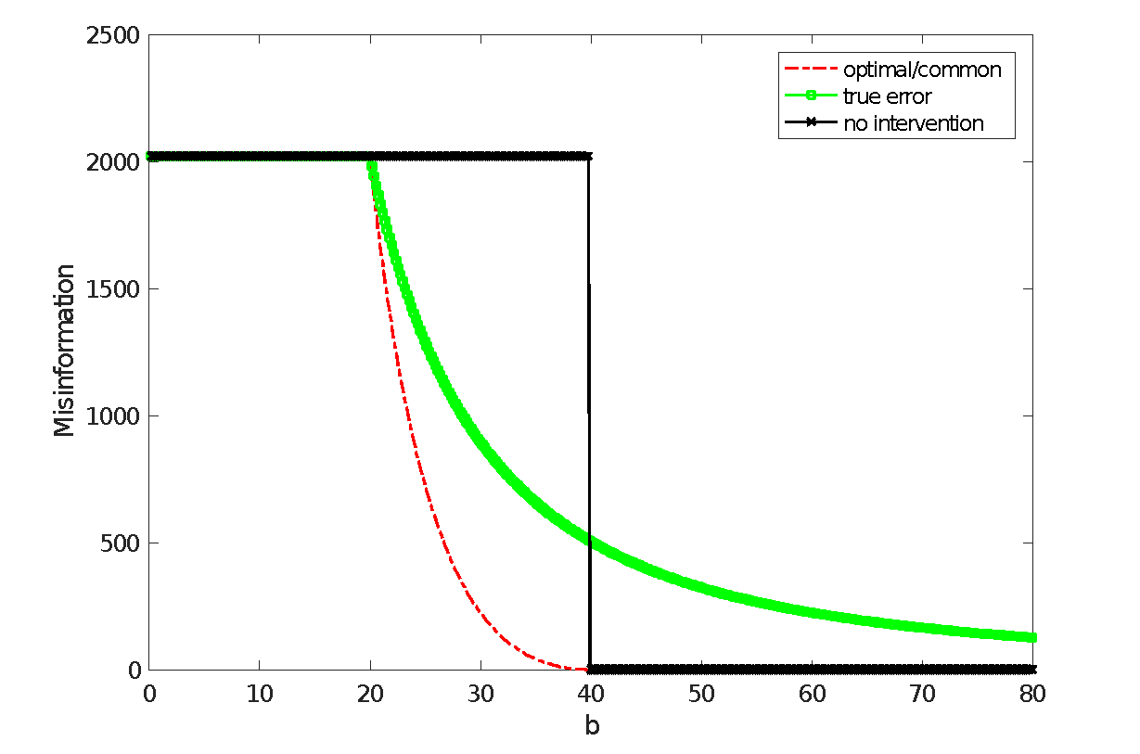
Applications
Fake news
Candogan and Drakopoulos 2018

Slide 14
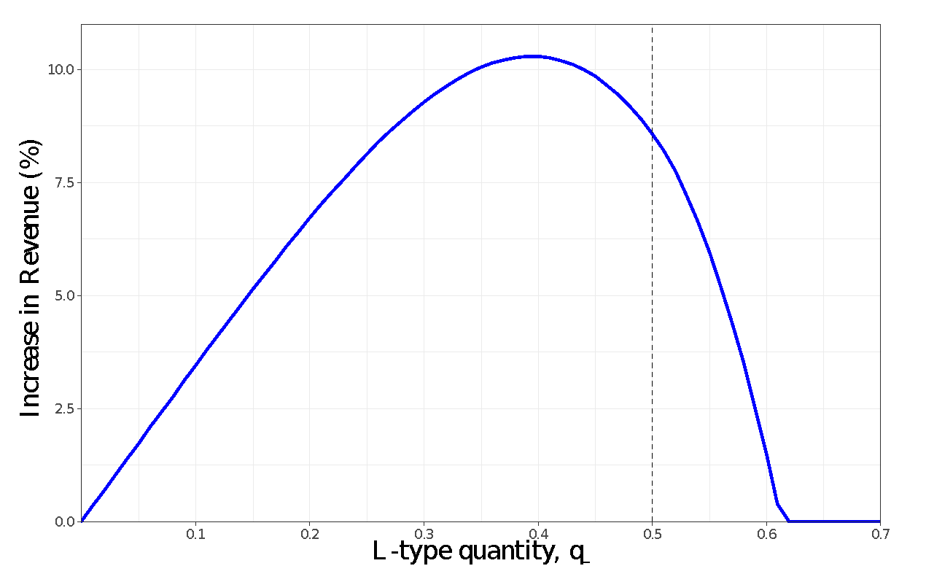
Applications
Pricing
Drakopoulos, Jain, Randhawa 2019

Slide 15
Blockchain
What is the role of blockchain
Underlying assumption that seller or platform can COMMIT.
How to implement commitment?
Same idea as smart contracts but now with information.

Slide 16
Blockchain
EY Vision
Deep Ghumman

Slide 17
Our Vision
Blockchains will do for networks of enterprises and business ecosystems what enterprise resource planning (ERP) did for the single company.

Slide 18
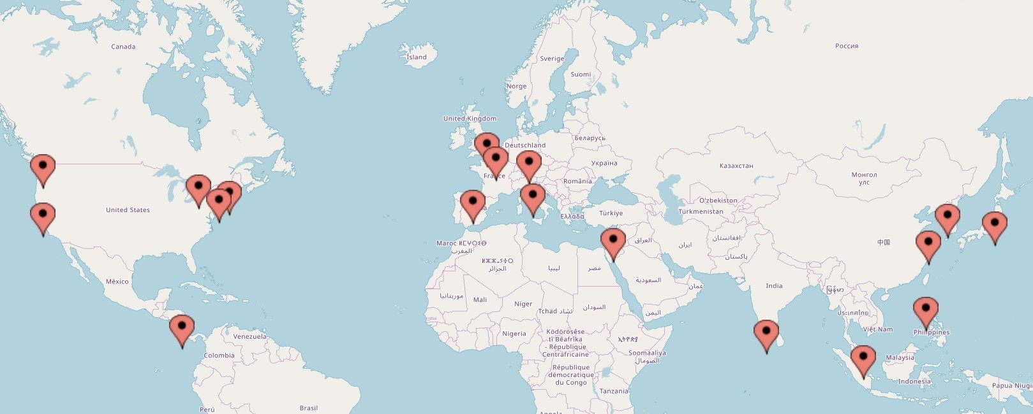



Our global blockchain capabilities stretch across consulting, development and delivery
Development:
Research:
Trivandrum, India
San Jose, Costa Rica
Madrid
Cambridge, MA
London
Paris
Tel Aviv
Client Delivery:
London
Paris
Munich
Rome
Manila
Tel Aviv
Singapore
Tokyo
Shanghai
Seoul
Seattle
San Francisco
New York
Toronto
Project volume worldwide has grown enormously …
Filed multiple patents in encryption and blockchain solution design
Building out delivery and support infrastructure in software-as-a-service (SaaS)
Delivering at scale with our Microsoft and SAP partnership

Slide 19
How will the future look? And how will we get there?
We anticipate four major transitions for wide corporate adoption of blockchain​
Blockchains will integrate information and process within and across enterprise boundaries.
Notarization
Crypto
Separated
Private
¥
Using tokens and contracts will be the standard way in which companies transact with each other.
Tokenization
Fiat
Integrated
Public

Slide 20
Ann McCormick

Slide 21
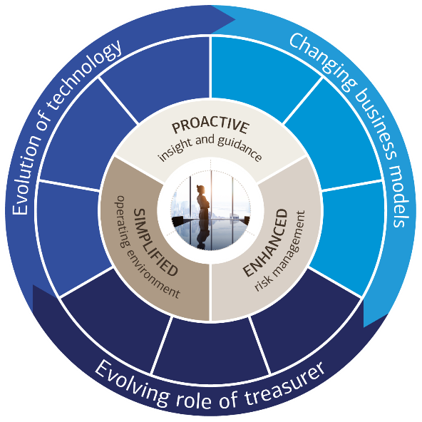
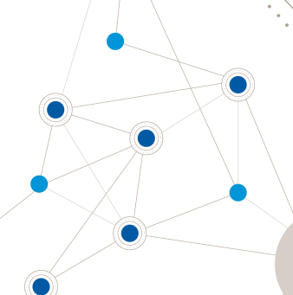
Drivers of change
“Smart”
evolution
Globalization
The global operating
market is changing.
Emerging
tech
Digital
commerce
Big data
Regulation
Strategic
function
ESG
M&A

Slide 22
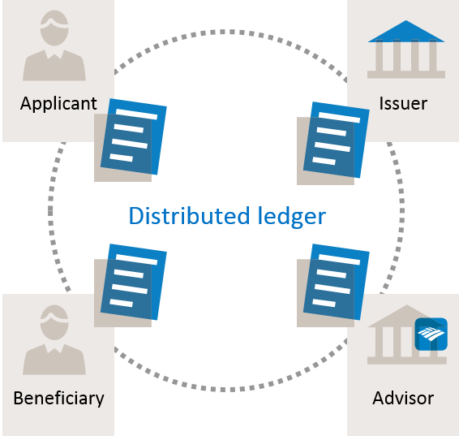


Innovation example: Standby letters of credit
Proof of Concept
By converting paper to digital through blockchain and availing to all parties, trade transacting becomes more efficient for all parties.
Trade finance
Cross-border treasury payments & receipts
Directed/non-directed FX flows
Potential benefits
Near real-time collaboration among all participants within the blockchain
Secure transaction initiation, request and updates
Distributed network for cross-party validation
Immutable data entry reduces risks
Automatic data updates expedite actions
Proof of concept use case
Trade finance today…
Trade finance with blockchain…
Inefficient document exchange

Slide 23





Revolutionizing the supply chain with blockchain
Physical Supply Chain DLT
Payments DLT
Registries DLTs: AML, KYC
Other DLTs
Trade Finance Distributed Ledger
Through the integration of physical and financial supply chains, blockchain has the
potential to enable digitization and authentication of trade transactions never
before possible.

Slide 24

Blockchain: What to expect
    Blockchain in financial services – and across all industries – is still in its infancy, with many obstacles ahead. As an industry, we must be prudent in our approach, collaborating closely with incumbents, innovators and regulators.
Integration
Significant changes to, or complete replacement of, existing systems.
    Interoperability between blockchain and legacy systems.
Scalability
OBSTACLES
Because blockchain is a network, mass market of participants needed.
Standards must be developed before mass market adoption.
Regulatory
Legal and regulatory issues and uncertainty must be resolved.
2016–2018
2019–2021
2022+
EXPERIMENT & MONITOR
Focus on select Proof of Concepts
Selectively engage with industry
LEARN & EVOLVE
Small number of implementations
Small scale with limited participants
EXPAND
Broaden adoption with proven results
Larger scale with rapid adoption

Slide 25
Bhaskar Krishnamachari

Slide 26

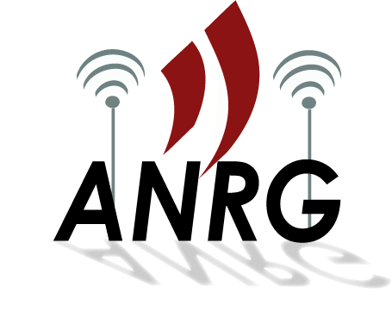
Internet of Things and Blockchain Technologies
Bhaskar Krishnamachari
Professor of Electrical Engineering & Computer Science (Jt. Appt.)
Director of CCI, Viterbi School of Engineering,
University of Southern California
bkrishna@usc.edu
http://cci.usc.edu , http://anrg.usc.edu

Slide 27
http://cci.usc.edu

Slide 28
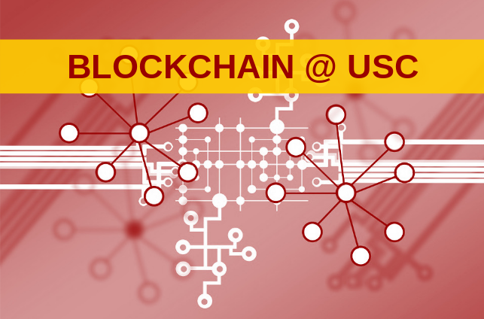
http://blockchain.usc.edu

Slide 29
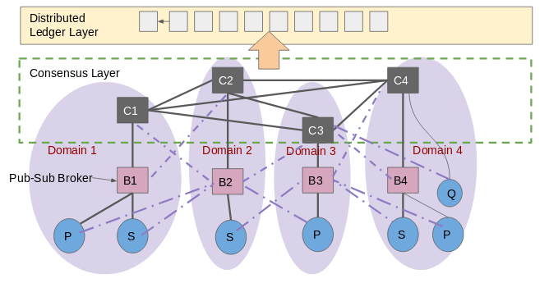
Trinity: Decentralized Publish-Subscribe
Several implementations: using MQTT+ Tendermint/Hyperledger/Ethereum/IOTA
Open Source release at https://github.com/ANRGUSC/Trinity
G. Ramachandran, K-L. Wright, L. Zheng, M. Naveed, B. Krishnamachari, J. Dhaliwal, "Trinity: A Byzantine Fault-Tolerant Distributed Publish-Subscribe System with Immutable Blockchain-based Persistence," IEEE International Conference on Blockchain and Cryptocurrency (ICBC), Seoul, South Korea, May 2019.

Slide 30
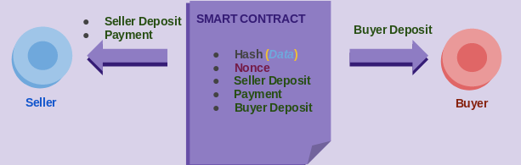
Buying and Selling Digital Goods Online without Trusted Third Parties
Double-deposit escrow smart contracts to guarantee honesty between buyers and sellers of known digital goods.
Aditya Asgaonkar, Bhaskar Krishnamachari, “Solving the Buyer and Seller’s Dilemma: A Dual-Deposit Escrow Smart Contract for Provably Cheat-Proof Delivery and Payment for a Digital Good without a Trusted Mediator,” IEEE ICBC, May 2019.

Slide 31
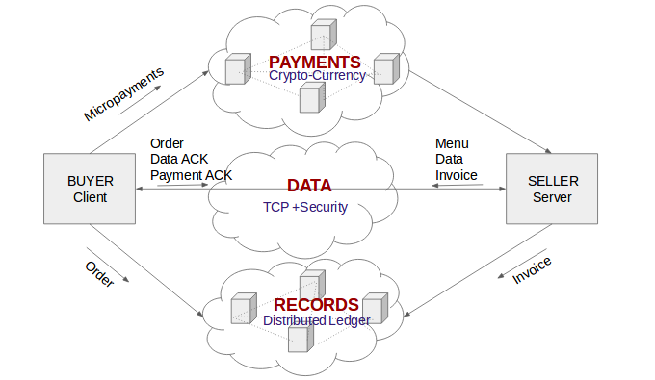
Streaming Data Payment Protocol (SDPP)
https://github.com/ANRGUSC/SDPP
Rahul Radhakrishnan, Bhaskar Krishnamachari, “Streaming Data Payment Protocol (SDPP) for the Internet of Things” BIoT 2018: The 1​st​ International Workshop on Blockchain for the Internet of Things, held in conjunction with IEEE Blockchain, Halifax, Canada, 2018.

Slide 32
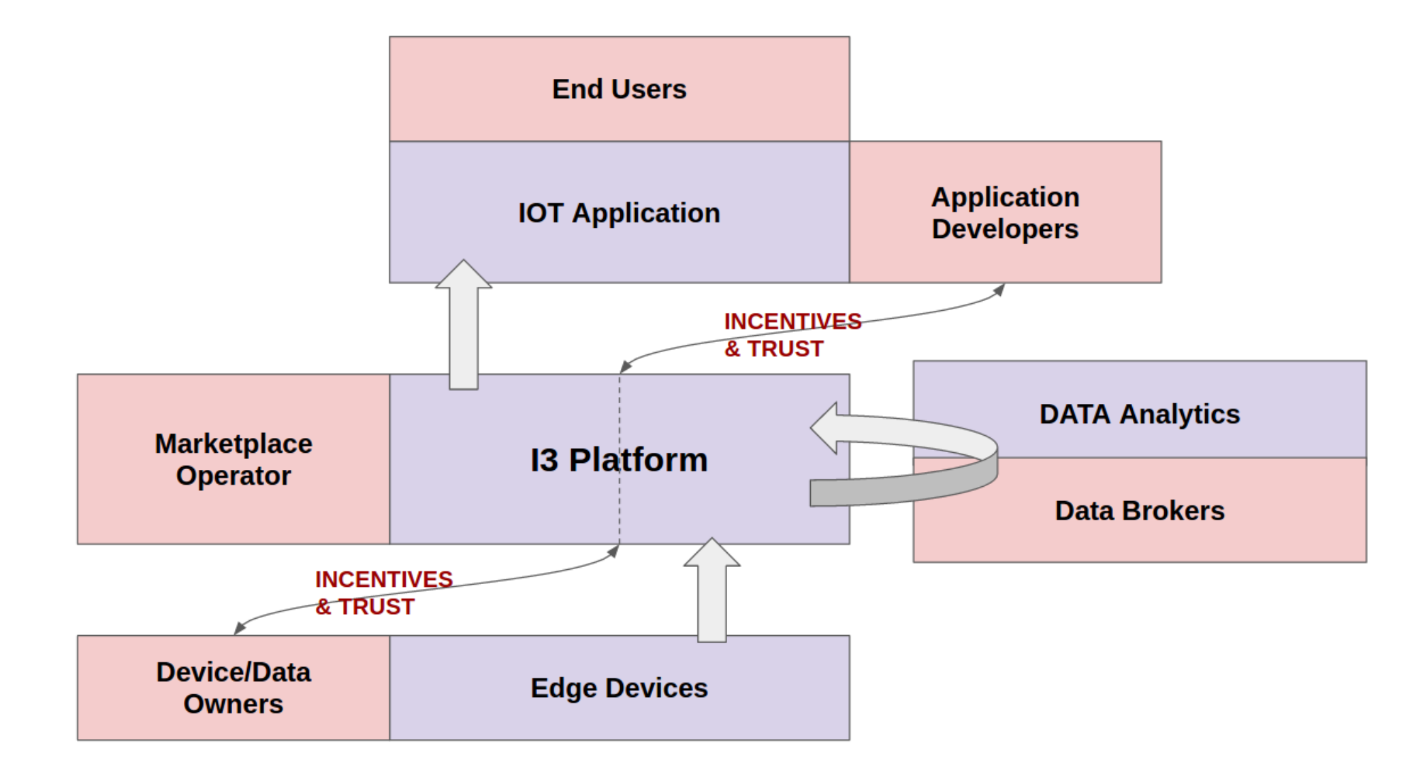
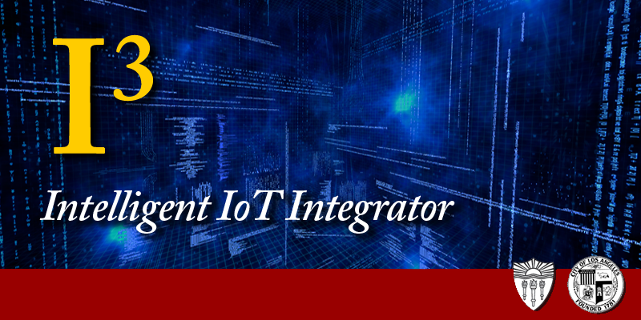
I3: Real-Time IoT Data Marketplace for Smart Cities
Next I3 Conference at USC: August 19, 2019
http://tiny.cc/i3aug19
The I3 Consortium: A public-private partnership led by USC, supported by the City of LA, and several companies and research institutions from around the world.
http://i3.usc.edu/

Slide 33
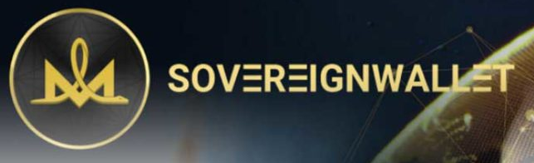

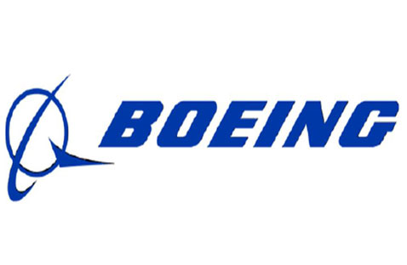
Ongoing Industry Collaborations
Blizzard: a Mobile-first Consensus Protocol
In Collaboration with
Decentralized Computation
In Collaboration with
SwarmDAG: Consensus in Partitioning Networks
In Collaboration with

Slide 34
Challenges and Opportunities
Pushing technology boundaries to address scalability, energy-efficiency, privacy
Building the “data value chain” and integrating it closely with supply chain
Systems that incorporate AI, Blockchain and Connected Devices (IoT) in a meaningful manner to deliver value to business ecosystems

