Slide 1
Disruptive Technologies Panel

Slide 2
Disruptive Technologies
Surviving Disruption
Monetizing / Profiting using Disruptive Technologies

Slide 3
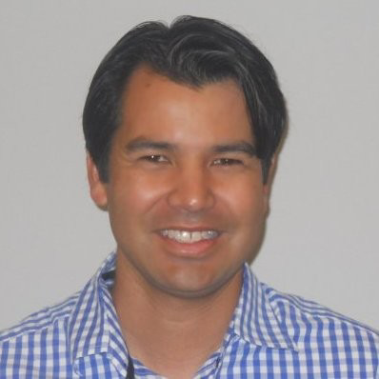
Wayne Jepson
ArcBest
Executive Director, Enterprise Solutions- International
Conor Nolan
Kontainers
VP North America
Greg Kessman
SupplyPike
President
Sascha B. Peyer
Sensor Transport
Co-Founder
Mark Gamble
Winmore
Head of Product Marketing
Jonathan Rosenthal
Saybrook
CEO
Michael Paldino
RevUnit
Co-Founder

Slide 4
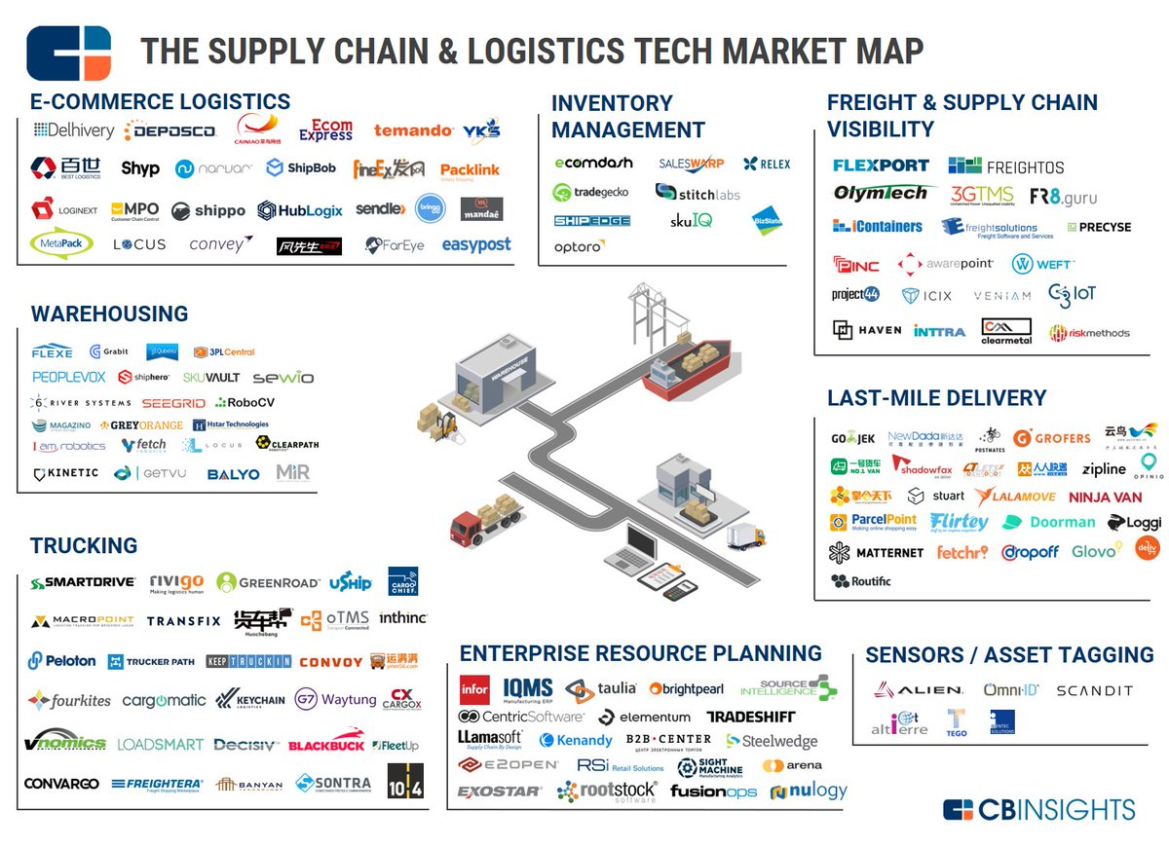
The Landscape

Slide 5
Disruptive Technologies
How do you decide on what and where to focus?

Slide 6
Disruptive Technologies
What are the greatest barriers to moving forward?

Slide 7
Disruptive Technologies
What strategies are being used to successfully engage these companies or service providers?

Slide 8
Disruptive Technologies
What technologies do you think will have the greatest impact on our industry?

Slide 9
Disruptive Technologies
What impact will disruptive technologies have on the workforce?

Slide 10
Disruptive Technologies
Data & Analytics – let’s talk about what is important and what the challenges are?

Slide 11
Disruptive Technologies
What strategies are being used to survive disruption?

Slide 12
Disruptive Technologies
What creative strategies are being used to profit from disruption?

Slide 13
Disruptive Technologies
What’s the one thing you’d like to leave the audience with?

Slide 14
Disruptive Technologies
Q & A

