Slide 1
Lloyd’s: City Risk Index USC Global Supply Chain Excellence Summit
Hank Watkins
President
North America
August 3, 2018

Slide 2
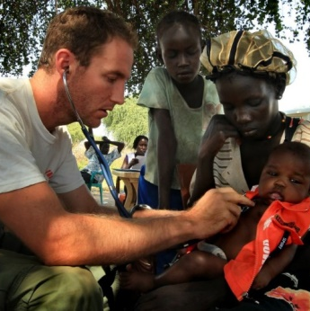
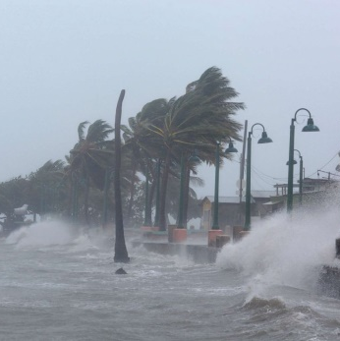
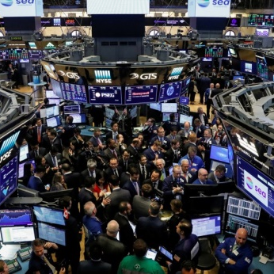
GDP at risk in 279 cities = $546 billion Threat sources: Man-made (59%) vs Natural (41%)
Categories 5 | Threats 22
Geopolitics
and Security
Health
and Humanity
Natural Catastrophe
and Climate
Technology
and Space
Finance, Economics
and Trade
Civil Conflict
Interstate Conflict
Social Unrest
Terrorism
Human Pandemic
Plant Epidemic
Drought
Earthquake
Flood
Freeze
Heatwave
Temperate Windstorm
Tropical Windstorm
Tsunami
Volcano
Cyber Attack
Nuclear Accident
Power Outage
Solar Storm
Commodity Price Shock
Market Crash
Sovereign Default
Notes:
22 threats are subdivided into 5 categories. Geopolitics and security includes the threats we have included in the index for the first time: civil conflict, interstate conflict and social unrest.
Natural catastrophe and climate includes windstorm which we have separated into two threats: tropical and temperate windstorm.

Slide 3
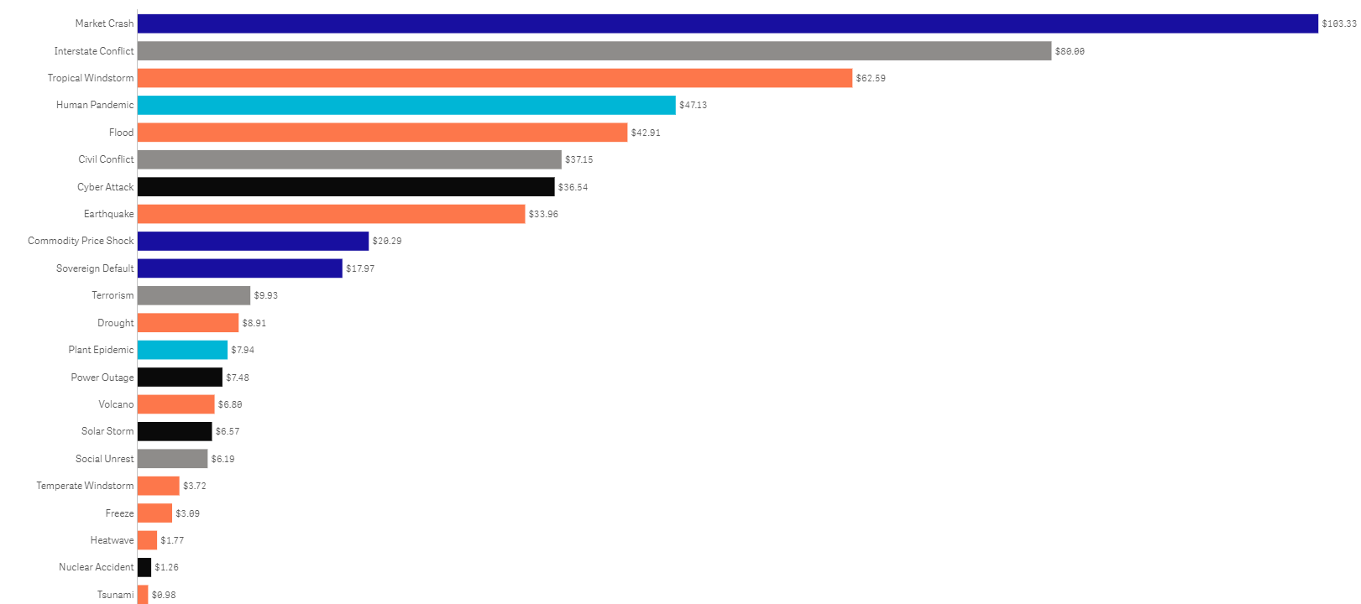
22 threats, 279 cities: breakdown of GDP@ risk
Market Crash
$103.33
Interstate Conflict
$80.00
Tropical Windstorm
$62.59
Human Pandemic
$47.13
Flood
$42.91
Civil Conflict
$37.15
Cyber Attack
$36.54
Earthquake
$33.96
Commodity Price Shock
$20.29
Sovereign Default
$17.97
Terrorism
$9.93
Drought
$8.91
GDP@Risk (bn)
$546.50
$7.94
Plant Epidemic
$7.48
Power Outage
$6.80
Volcano
$6.57
Solar Storm
$6.19
Social Unrest
$3.72
Temperate Windstorm
$3.09
Freeze
$1.77
Heatwave
$1.26
Nuclear Accident
$0.98
Tsunami
Notes:
Globally the Index finds that $546bn is at risk annually. This slide shows the breakdown of individual threats.
The most costly threat globally is market crash with a sum of $103bn. In part this is due to its prevalence. Over 90% of cities are exposed to this threat. For many cities, particularly in Europe and the US, it is the largest individual threat to the GDP of cities.
Interstate conflict is a new addition to this addition of the risk index. It is in second place globally, with an expected cost of $80bn. However, it is less common than interstate conflict, with the potential to affect around two-thirds of cities.
Tropical windstorm is the third largest threat, by GDP@Risk, with a cost of $63bn. In 2017, we experienced a number of devastating, and costly storms such as ABC. However, this is a particular threat in Asia, where it is the single largest risk to the GDP of cities.
The threat with the lowest GDP@Risk is Tsunami, and this is a reminder against complacency. Tsunami only affects 16 cities in our index, and when losses are averaged over time, the overall annual figure is less than $1bn. However, as the Boxing Day Tsunami of 2004 showed, rare events such as Tsunami can have a devastating impact on communities and economies in coastal areas.
Just 10 threats account for 91% of Total GDP@Risk.
Market crash represents nearly a quarter of all cities’ potential losses.

Slide 4
Global overview and top ten cities
Total GDP@Risk from all threats $546.5bn
GDP (bn) – 279 cities $35,404.22 | GDP@Risk (bn) $546.50 | % of GDP@Risk 1.54%
Threat Categories
Top 10 Cities
Most At Risk
Threat | GDP@Risk (USD)
Market Crash Interstate Conflict Tropical Windstorm Human Pandemic Flood Civil Conflict Cyber Attack Earthquake Commodity Price Shock Sovereign Default Terrorism Drought Power Outage Plant Epidemic Volcano Solar Storm Social Unrest Temperate Windstorm Freeze Heatwave Nuclear Accident Tsunami | 103.3bn 80bn 62.6bn 47.1bn 42.9bn 37.1bn 36.5bn 34bn 20.3bn 18bn 9.9bn 8.9bn 7.5bn 7.9bn 6.8bn 6.6bn 6.2bn 3.7bn 3.1bn 1.8bn 1.3bn 1bn
# | Global City | GDP@Risk (USD) | Biggest Risk
1 | Tokyo | 24.3bn | Interstate Conflict
2 | New York | 14.8bn | Market Crash
3 | Manila | 13.3bn | Tropical Windstorm
4 | Taipei | 12.9bn | Tropical Windstorm
5 | Istanbul | 12.7bn | Interstate Conflict
6 | Osaka | 12.4bn | Interstate Conflict
7 | Los Angeles | 11.6bn | Flood
8 | Shanghai | 8.5bn | Tropical Windstorm
9 | London | 8.4bn | Market Crash
10 | Baghdad | 7.9bn | Interstate Conflict
Notes:
The single category which leads to the most GDP@Risk is natural catastrophe and climate, accounting for almost a third of the $546bn at risk.
Despite this, man-made risks still account for a larger amount of the overall risk, at 59% of the whole.
It is a salutary reminder that human action, whether through market crash, conflict or cyber attack, creates loss.
These risks are also, perhaps, harder to predict and therefore mitigate against. Human nature is, after all, erratic. This is a particular issue for insurers who must be able to model these risks in order to provide products to protect communities from their affects. While this is difficult, it is not impossible. The Lloyd’s market offers products for most of these risks under scrutiny.

Slide 5
Building resilience – key steps and outcomes
Pre-event risk anticipation and mitigation is critical
By providing cash injections following a catastrophic event, insurance is part of the solution
Insurers and brokers, partnering with risk managers, must invest in developing new products
While no city can be completely risk free, pro-active risk management can minimise the impact of threats to individuals, businesses and their communities
Improved resilience can preserve $73.4bn annually

