Slide 1
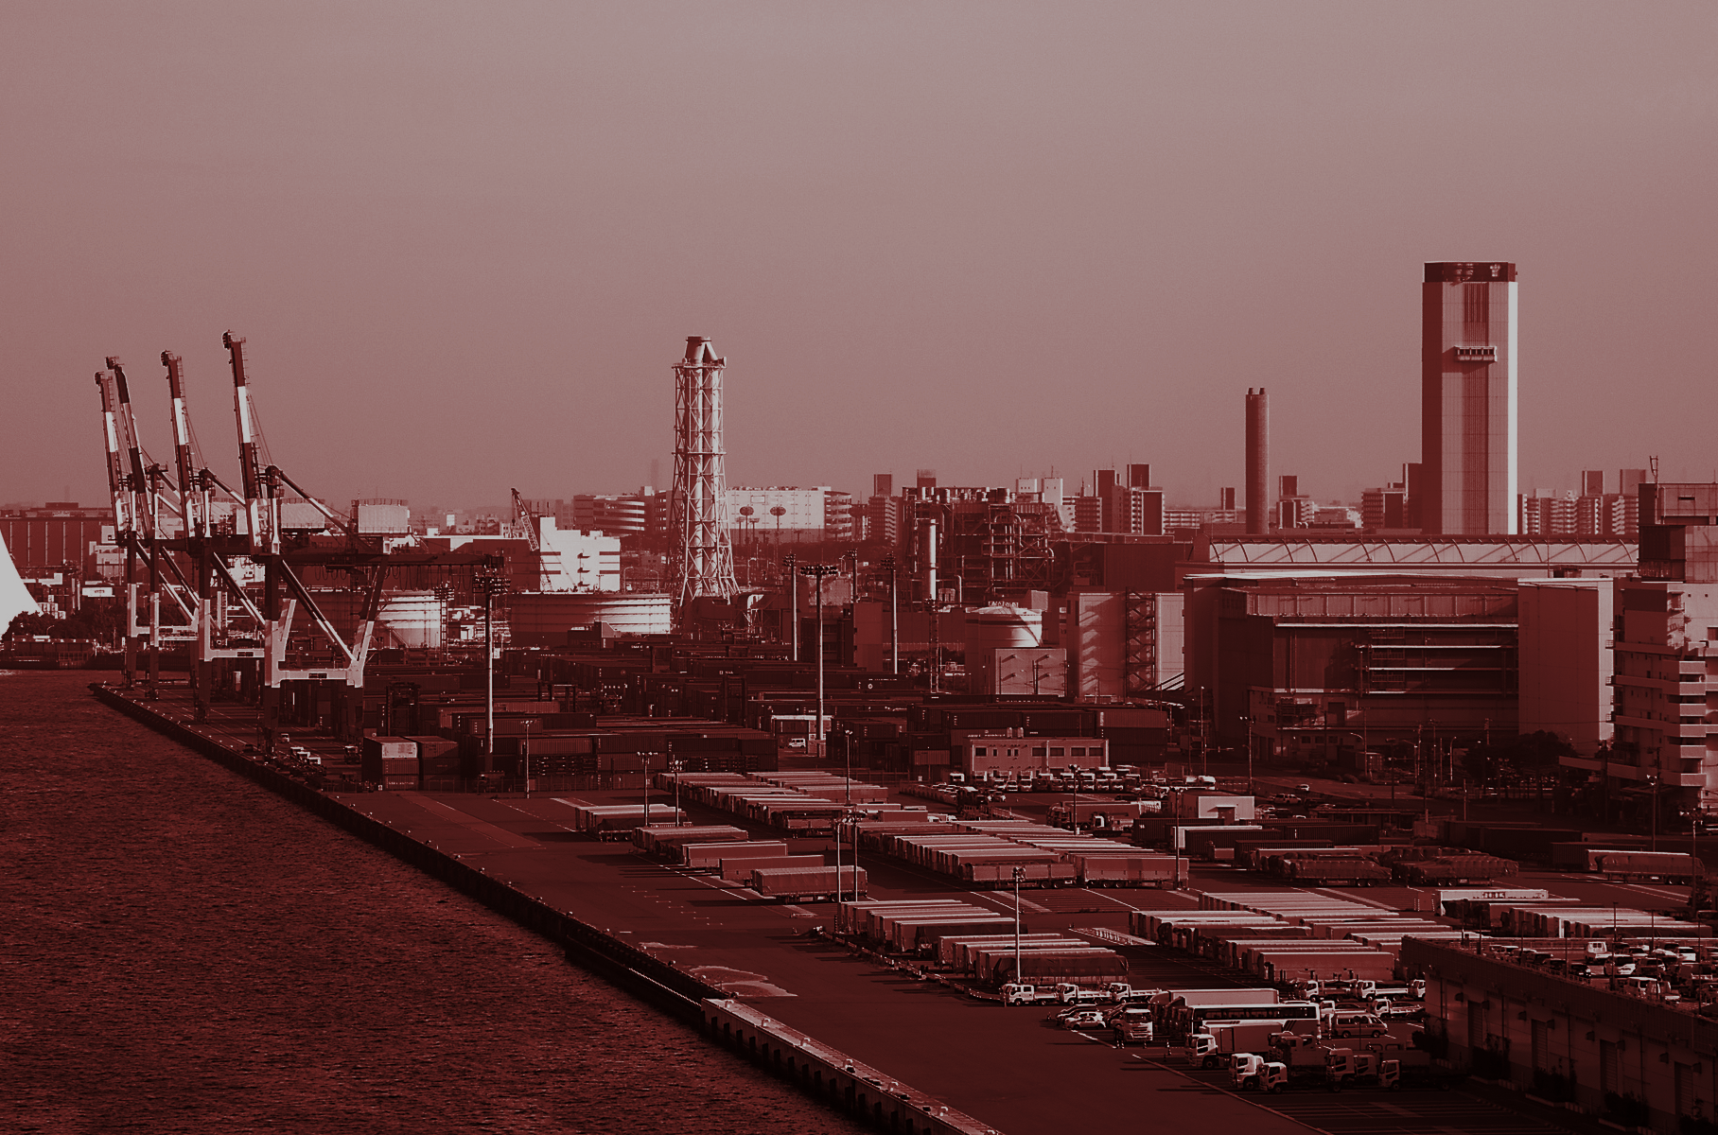
Sustainability
Panel

Slide 2
Greys Sosic
USC
USC Marshall Associate Professor, Data Science & Operations
Heather Tomley
Port of Long Beach
Acting Managing Director of Planning & Environmental Affairs
Kelly Liu
Cisco
Sustainability Manager, Supply Chain Social and Environmental Responsibility
Kevin Quandt
Sweetgreen
VP of Supply Chain/Sustainability
Erwin Rademaker
Port of Rotterdam
Programme Manager
Lee Kindberg
Maersk
Head of Environment and Sustainability

Slide 3
Sustainability issues across industries

Slide 4
Industries
We have participants from very different industries at the table:
Technology
Food
Logistics

Slide 5
What do you see (in 3 minutes or less) as the biggest challenges and successes in implementation of sustainability efforts in your industry, and specifically, for your company?

Slide 6
Today’s Topics
Sustainability across supply chains
Business power autonomy
Social Sustainability

Slide 7
Sustainability in global supply chains

Slide 8
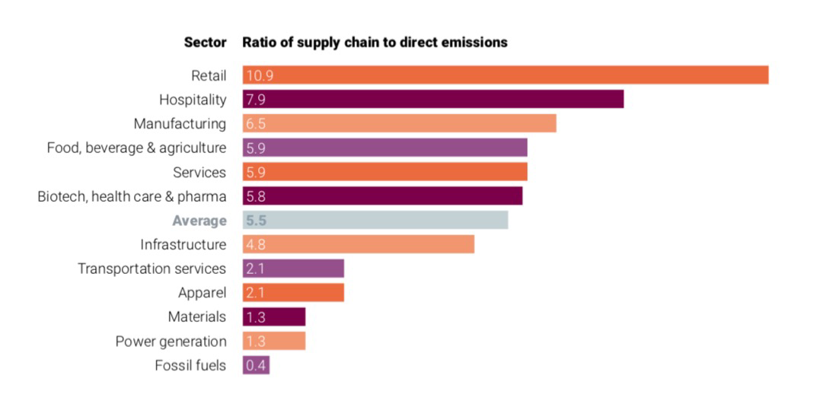
CDP — Cascarding Commitments: Driving upstream action through supply chain engagement (2019).

Slide 9
CDP — Cascarding Commitments: Driving upstream action through supply chain engagement (2019).
A company’s supply chain contains on average 5.5 times as GHG emissions as its own operations
In 2018, 115 of the world’s largest companies requested environmental information from more than 5,500 suppliers. When Supply Chain Disclosure program started 10 years ago, just 14 companies took part.
In 2018, those suppliers reported emissions reduction of 633 million metric tons of carbon dioxide leading to cost savings of US $19.3 billion
“...there’s so much shared value to be found in greening the supply chain, which can help to increase efficiency, reduce resource costs, enter new markets, and make supply chains more resilient to the changing climate and a changing world.” — Hugh Jones, Managing Director, Advisory, The Carbon Trust

Slide 10
Companies trying to become more sustainable start with their own operations, but soon realize that most of their impacts are in their supply chains rather than in-house...
How is this reflected in your industry? How is your company specifically approaching this?

Slide 11
Business power autonomy
Biosphere Rules, Gregory Unruh

Slide 12
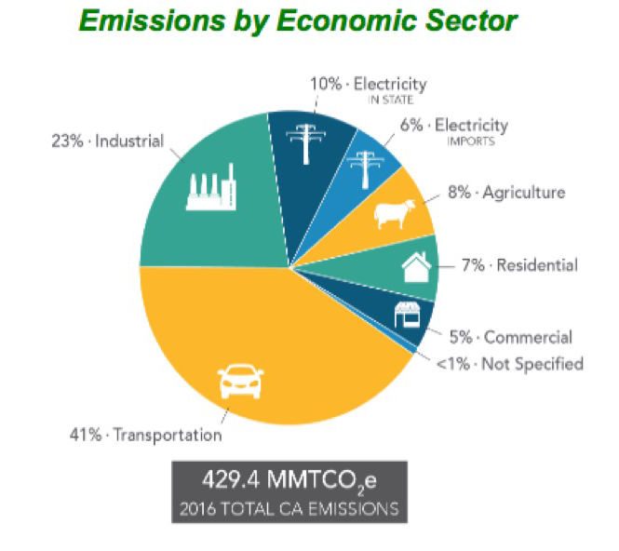
California Greenhouse Gas Emission Inventory - 2018 Edition

Slide 13
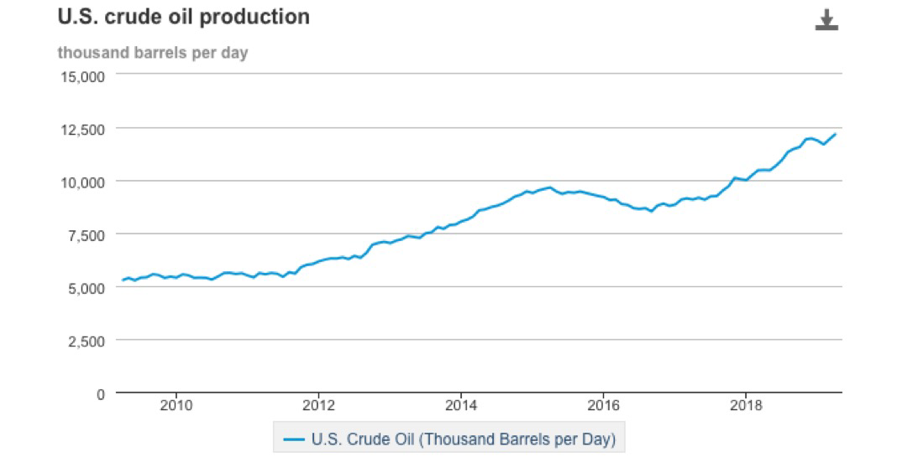
US oil production is on track to spike to a record 13.4 million barrels per day by the end of 2019, according to a recent report by the energy research firm Rystad Energy

Slide 14
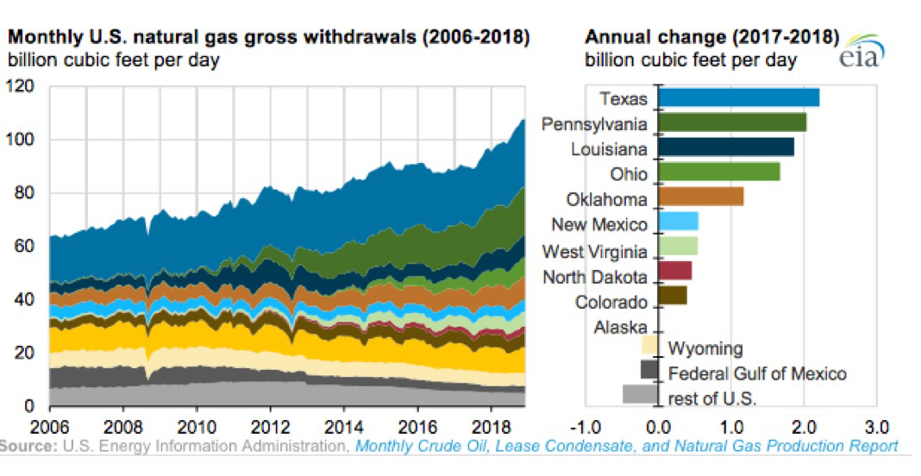
U.S. Natural Gas production grew by 10.0 billion cubic feet per day (Bcf/d) in 2018, an 11% increase from 2017

Slide 15
Human Manufacturing has relied primarily on fossil fuels like oil, gas, and coal to extract and transform materials. To achieve power autonomy, we first need to increase the energy efficiency of products and production processes, and then adopt renewable energy technologies to move the business towards a state of autonomous power generation.
How is this reflected in your industry? How is your company specifically approaching this?

Slide 16
Social Sustainability as a part of CSR

Slide 17
The products we buy should not come at the cost of workers’ rights. The Fair Labor association believes that all goods should be produced fairly and ethically, and brings together three key constituencies - universities, civil society organizations (CSOs) and companies - to find sustainable solutions to systemic labor issues.
- Fair Labor Association

Slide 18
Forced labor can be understood as work that is performed involuntarily and under the menace of any penalty. It refers to situations in which persons are coerced to work through the use of violence or intimidation, or by more subtle means such as manipulated debt, retention of identity papers or threats of denunciation to immigration authorities.
- International Labor Organization

Slide 19
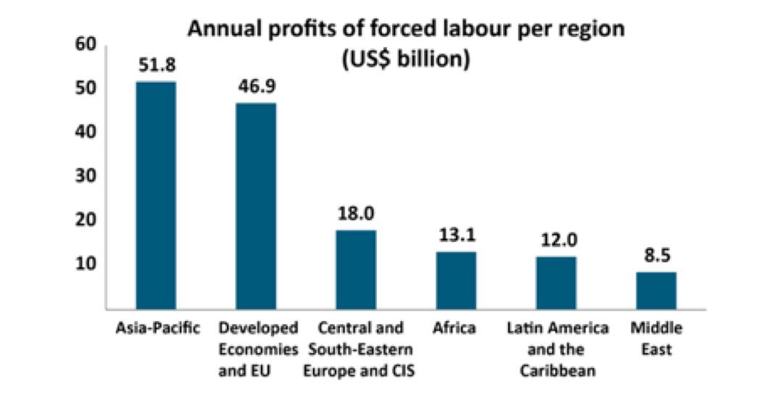
Forced labor generates annual profits of $150 billion

Slide 20
Supply Chain Automation is gaining ground, particularly in warehousing and middle- and last-mile logistics.
Supply chain automation isn’t limited to finding more efficient ways to pick or move products—gathering data for decision-making is a big driver of automation as well.

Slide 21
Keeping labor cost down
Improving Productivity
Improving Efficiency
Reducing the impact of labor shortage
Supply chain Automation helps in:

Slide 22
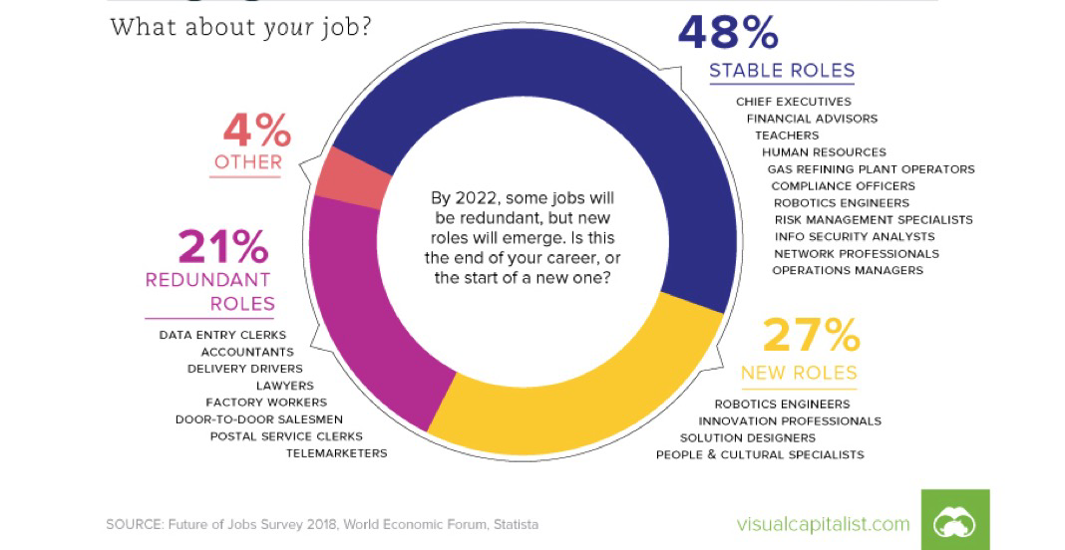
Some jobs are becoming redundant

Slide 23
Corporate Social Responsibility usually refers to a company’s commitment to practice environmental and social Sustainability and to be good stewards of the environment and the social landscapes in which they operate.
How is social sustainability practiced in your industry? How is your company specifically approaching this?

Slide 25
Last Thoughts?

Slide 27
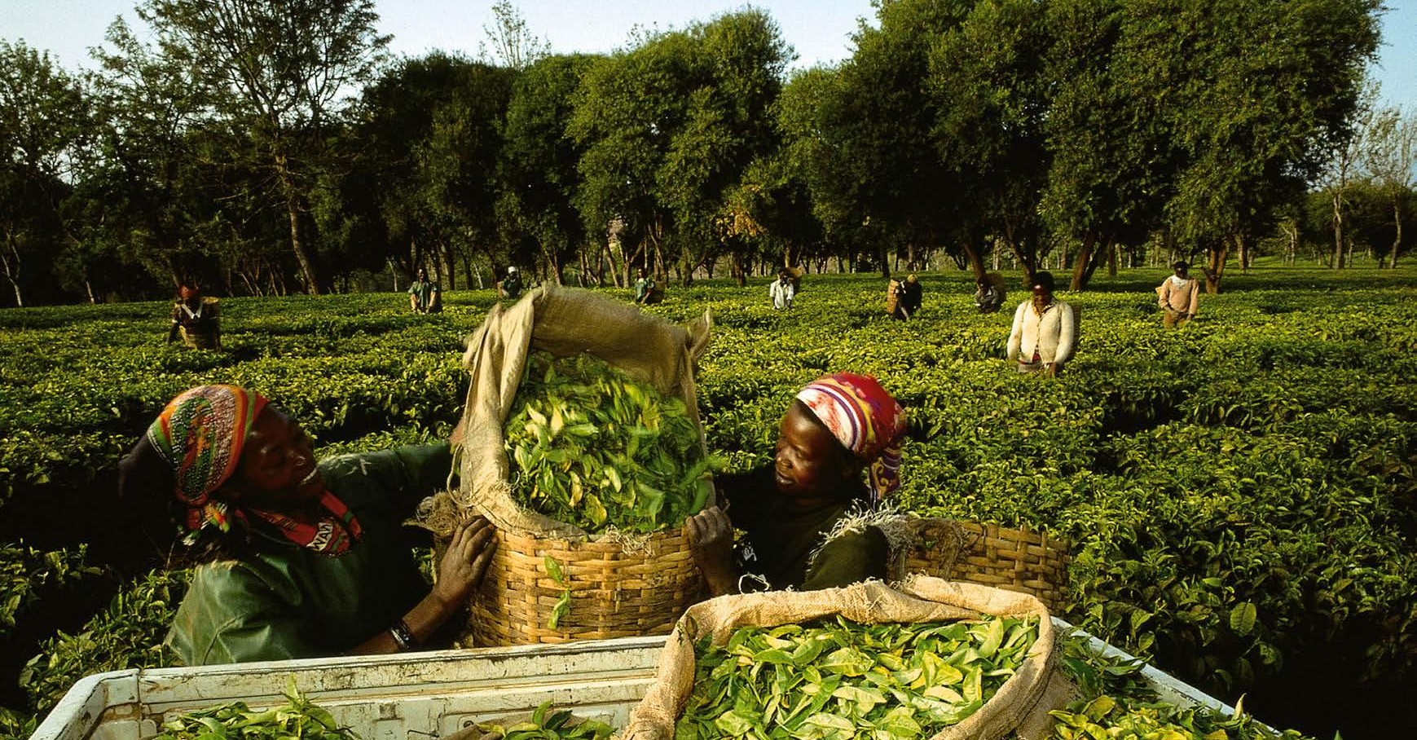
Sustainability in A.P. Moller - Maersk
SUSTAINABILITY IN MAERSK

Slide 28
Staying relevant in a changing world
Maersk’s
commitment to sustainability
Ensure safe, responsible and transparent business practices
Work systematically to reduce negative impacts and enhance positive impacts on people, society and environment
Engage with stakeholders in an upright and transparent manner
Take action through our business and in partnerships to be part of the solution to global sustainable development challenges
is cut-off date for a carbon-neutral economy
2050
IPCC, 2018
600 million jobs are needed in developing countries alone to keep up with current population growth estimates
600
World Bank, 2018
72%
of our customers seriously consider sustainability in managing their supply chains
2018 customer survey

Slide 29
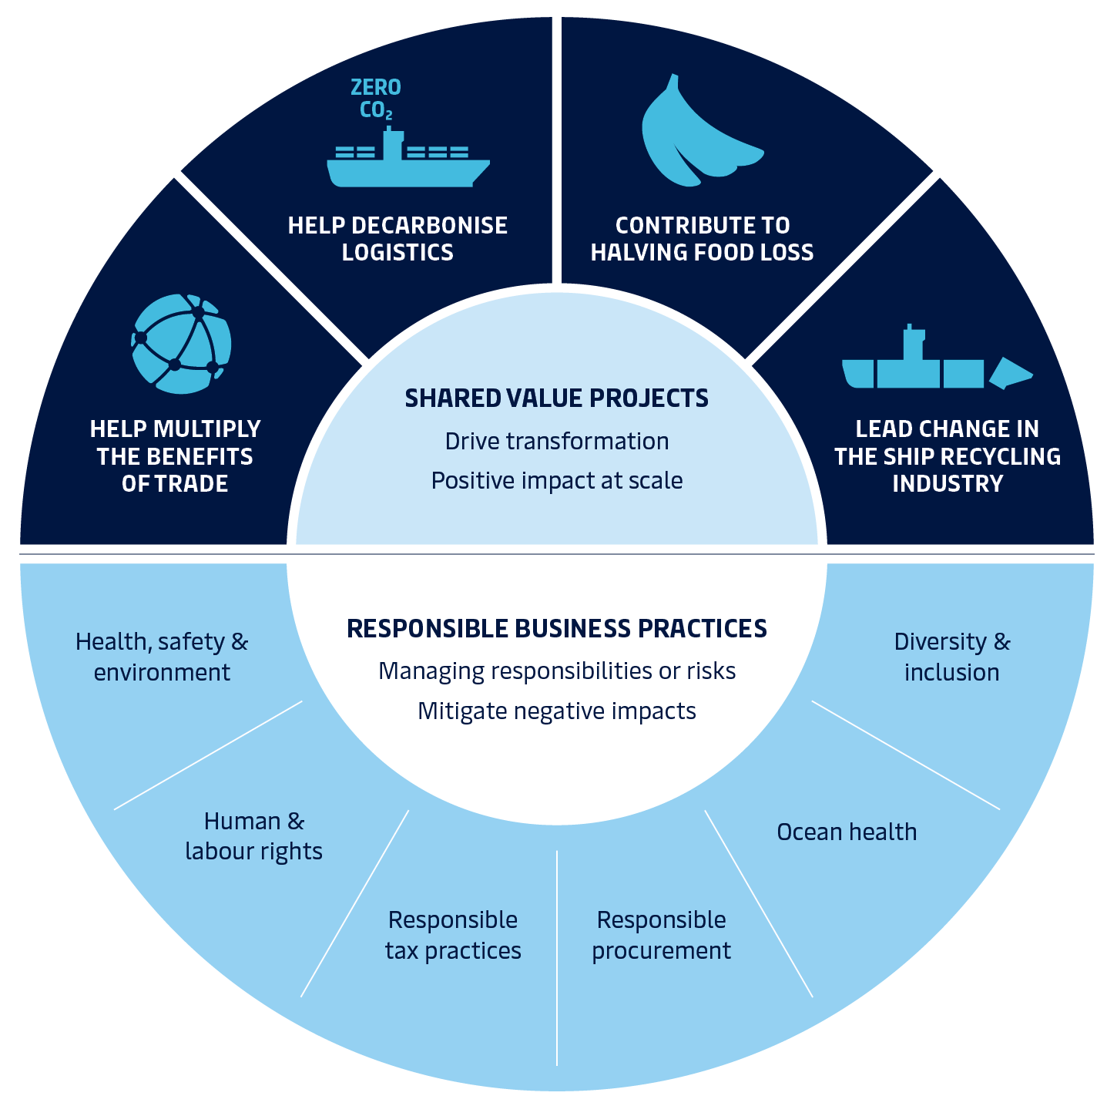
Our sustainability strategy

Slide 30
Halving food loss in logistics
1/3
of all the food wasted is lost during post-harvest and transportation
FAO.org
1.5tn
USD is the net value of all food that will be lost or wasted globally by 2030
BCG, 2018
60%
of the world’s 50 largest food companies by revenue have set specific food loss & waste reduction targets for their supply chain
WRI, 2019

Slide 31
Multiplying the benefits of trade
137,000
Trade has enabled an average of 137,000 people to lift themselves out of poverty every day for the past 25 years
S. Pinker, 2018
5%
Reducing logistics barriers to trade could increase GDP by nearly 5%, adding millions of jobs to the global economy
SWEF, 2013
2/3
Small businesses account for 2/3 of all jobs, but pay twice as much for logistics compared to large companies
WTO, 2016

Slide 32
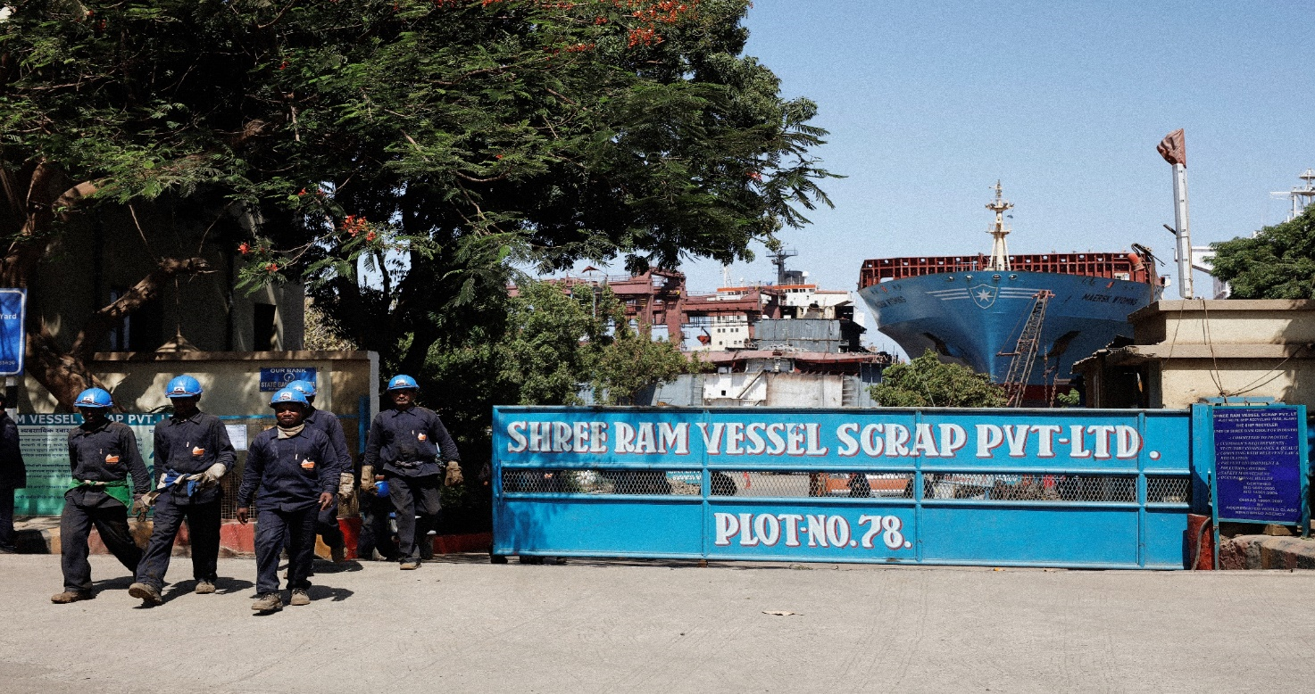
Lead change in the ship recycling industry
Maersk aspires to transform the ship recycling industry to promote responsible practices and greater transparency
All Maersk vessels are recycled according to our Responsible Ship Recycling Standard covering all relevant environmental and social sustainability topics

Slide 33
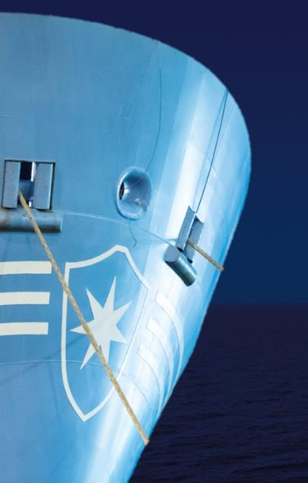
Working towards carbon-neutral shipping
Shipping is responsible for
2 – 3%
of global emissions
“
We have begun a journey towards having net-zero CO2 emissions from our own operations by 2050. This is an important ambition and one we can only deliver on in collaboration with many other stakeholders.
”
Søren Skou, CEO of A.P. Møller - Mærsk A/S
Our targets
2018 performance
ZERO
Net emissions from our own operations by 2050
60%
Relative reduction by 2030 (compared to 2008)
41%
Relative reduction YTD (compared to 2008)

Slide 34
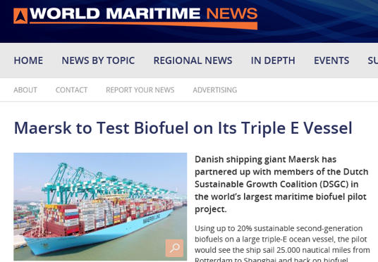
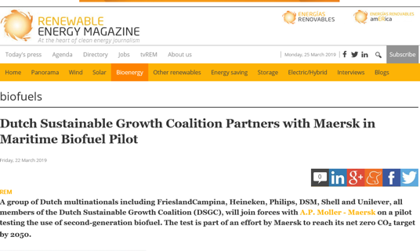
|34
Delivering commercially viable carbon neutral vessels by 2030
First commercially viable carbon-neutral vessel in operation
Innovate with partners
Zooming in
Decision Point
Design
Contract
Build
2019
2023
2027
2028
2030

